Slide 1
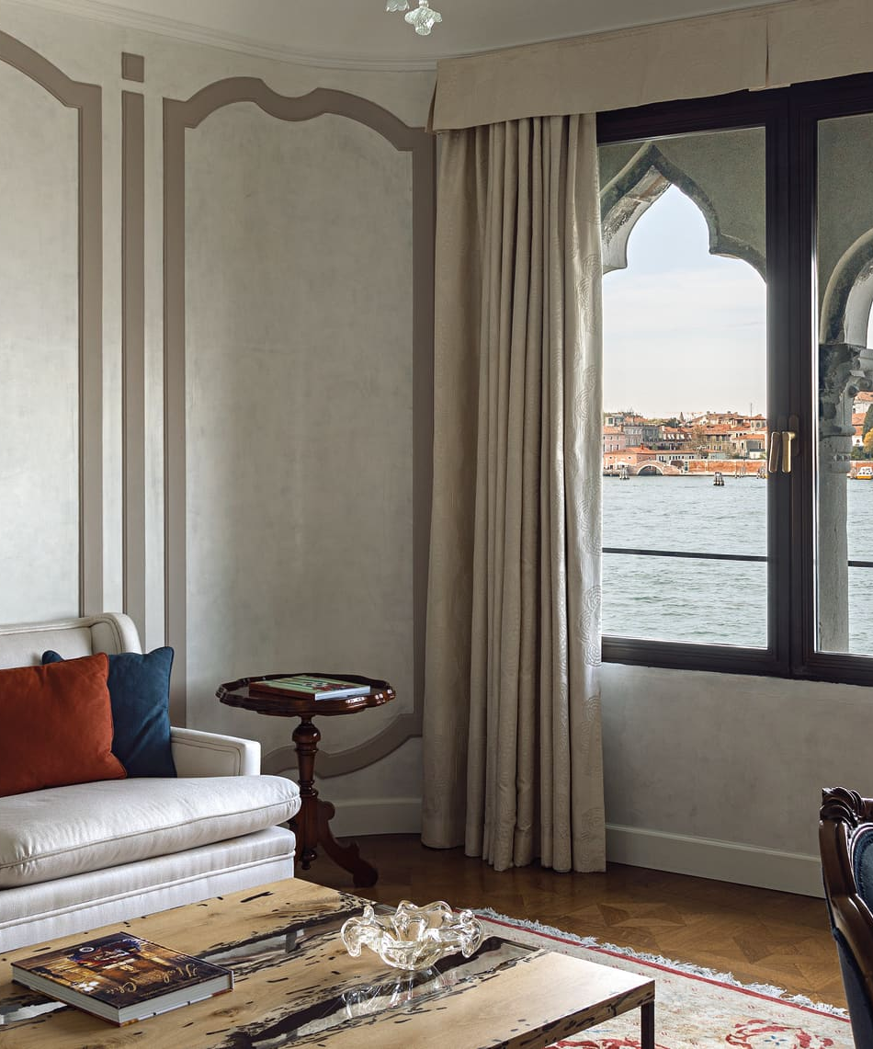
24 JULY — 14 AUGUST 2026
Venice,
then beyond.
Three exact 21-night routes for two adults and a 16-month-old.
DECISION DOSSIER
Rates are volatile snapshots—not held. Exact-party direct inventory is green; all other evidence is labeled.
Venice Biennale · Adriatic · Alps

Slide 2
VENICE + BEYOND
02 / Route comparison
The decision is about friction.
Every option totals 21 nights. The difference is how much transfer risk and inventory uncertainty you are willing to carry.
01
Slow Adriatic
Venice → Lake Bled → Istria → Opatija Riviera → Zagreb
3h45 max
Best overall with a toddler
Fewest difficult transfers, one seven-night residence and an airport-safe finish.
02
Island Grand Tour
Venice → Lake Bled → Rovinj → Mali Lošinj → Opatija Riviera
5h amber
Most distinctive; two ferry days
Čikat Bay, standout coastal resorts and a trip that feels unlike another Italy holiday.
03
Alpine Lakes
Venice → Lake Bled → Lake Fuschl → Lech am Arlberg → Lake Lucerne
4h50 max
Best premium-cabin exit
Cooler weather, dramatic scenery and a simple Zürich departure.
SOURCE Shared itinerary dataset ↗

Slide 3
VENICE + BEYOND
03 / Common Venice arrival
Private arrival: dock-to-door, not curb-to-door.
VCE General Aviation is the clean primary. Treviso is a land transfer plus a separate water-taxi handoff.
01
VCE GENERAL AVIATION
02
TREVISO CONTINGENCY
VCE → hotel dock
30–50 min
TSF → road → water
60–100 min
Prebook meet-and-greet at the FBO water dock.
Private launch handles luggage once; confirm the hotel dock is usable at arrival tide.
Cipriani is easiest by boat; Ca’ di Dio has the best Biennale walkability.
45–70 min car to Piazzale Roma or Tronchetto.
Then 15–30 min private water taxi; no direct boat from TSF.
ATVO coach is cheaper but adds fixed stops and a luggage transfer.
SOURCE VCE General Aviation ↗
SOURCE Official TSF transport ↗

Slide 4
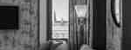
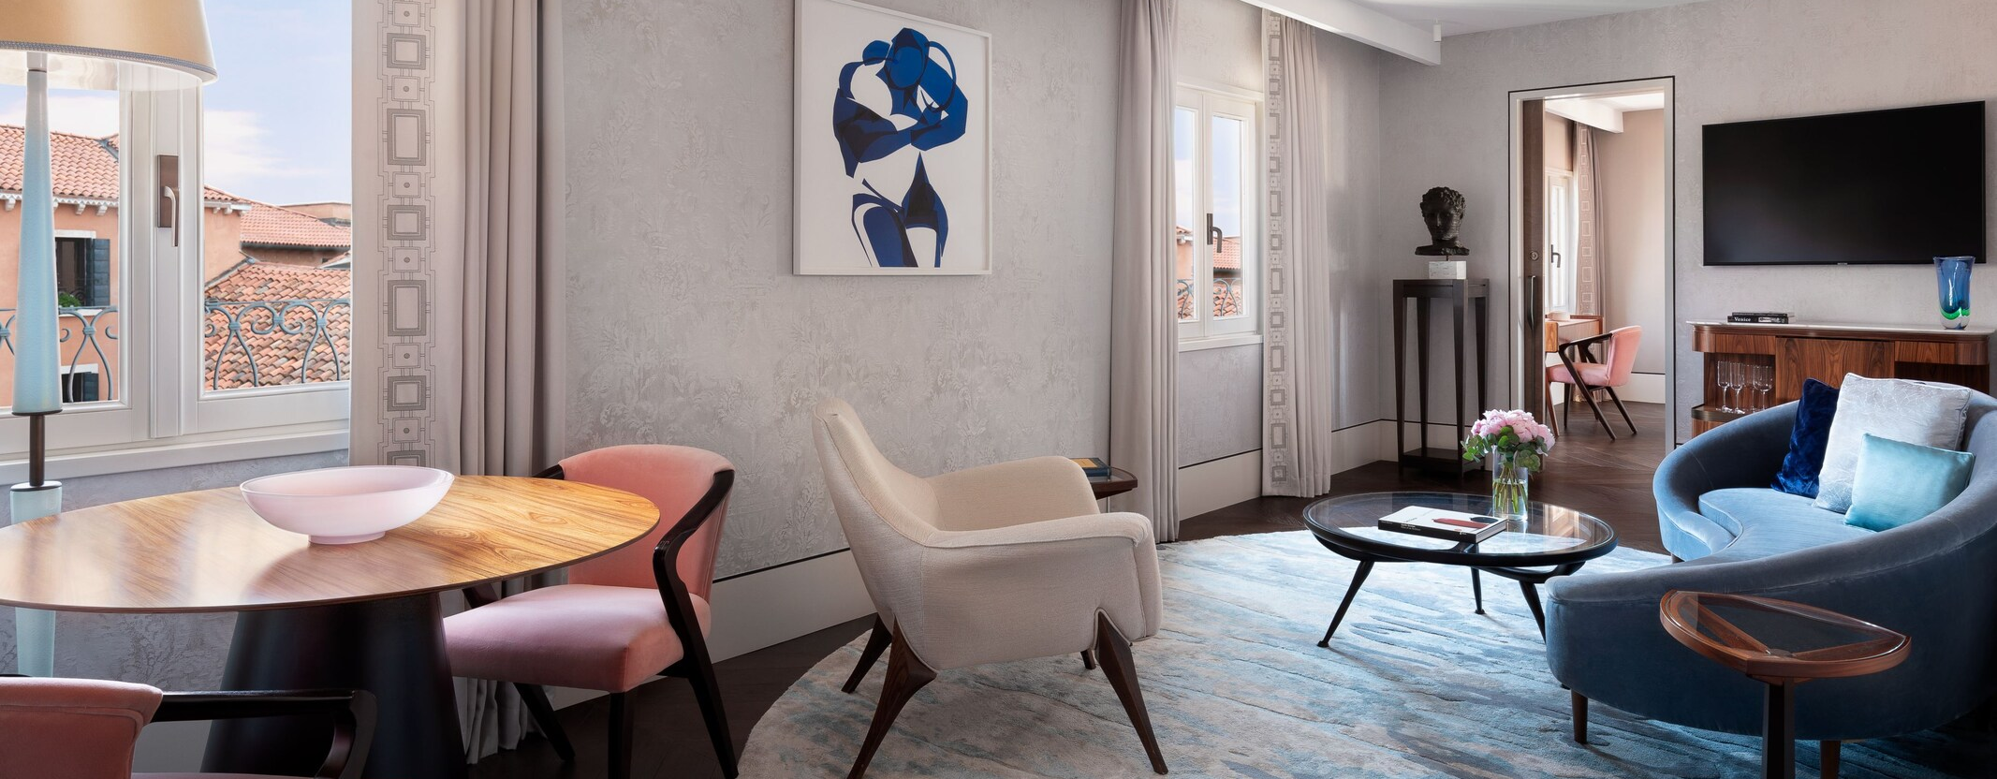
VENICE + BEYOND
04 / Venice hotels
Three live suites; three very different trips.
Direct engines showed the exact dates, room and full party on 15 July. Crib placement still needs written confirmation.
Hotel Cipriani, a Belmond Hotel
Ca’ di Dio
The St. Regis Venice
St Mark's View Suite
Suite Laguna View
St. Regis Suite, one bedroom
61–74 m²
€18,220.42 / 4 nights
41 m²
€5,428.10 / 4 nights
Not published reliably
€11,222 / 4 nights
Full stay + tax after 4 PM local, 10 July; effectively non-refundable now
Cancel by 2 PM local, 22 July; then 100% of stay
Free through 21 July
CHECK LIVE RATE ↗
CHECK LIVE RATE ↗
CHECK LIVE RATE ↗
SOURCE Direct property booking engines ↗

Slide 5
VENICE + BEYOND
05 / Biennale plan
Buy flexibility, then build around naps.
The €50 weekly ticket is the right tool: re-entry matters more than the €20 saving on the ordinary ticket.
FRI 24
Arrival / recover
Keep light
WEEKLY
€50
Arsenale · 11:00–20:00
SAT 25
Arsenale
per adult
SUN 26
Giardini · 11:00–19:00
Giardini
Re-enter around naps
Child 0–6 digital ticket is free
Buy online; FAQ says no date slot
MON 27
Closed · lagoon/rest
No ticket use
TUE 28
Optional short return
Keep light
Changing tables, stroller access, cloakrooms and food service are listed. Skip the scheduled 4–12 family tour for a 16-month-old; inquire only about a private guide.
SOURCE Official Biennale Arte 2026 information ↗

Slide 6
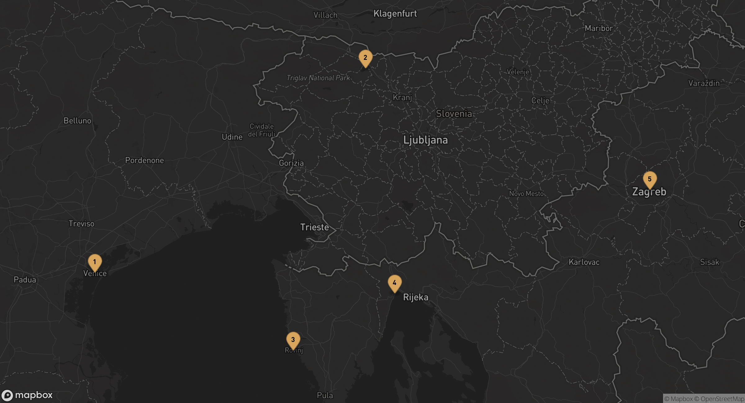
VENICE + BEYOND
06 / Slow Adriatic
Slow Adriatic · easiest with a toddler
Fewest difficult transfers, one seven-night residence and an airport-safe finish.
One villa-style week, no ferry
1
Venice
4n · 24–28 July
2
Lake Bled
4n · 28 July–1 August
3
Istria
7n · 1–8 August
4
Opatija Riviera
3n · 8–11 August
5
Zagreb
3n · 11–14 August
SOURCE Mapbox static map + route dataset ↗

Slide 7
VENICE + BEYOND
07 / Slow Adriatic
Four transfers, all with recovery margin.
Private driver is the cleanest baseline. Cross-border rental only after written approval and rear-facing seat confirmation.
01
Venice → Lake Bled
3h20–3h45
20–40 min traffic/rest stop
MAP ↗
Tue 28 Jul
02
Lake Bled → Meneghetti / Istria
3h–3h30
Vignette/toll + child stop
MAP ↗
Sat 1 Aug
03
Istria → Opatija
1h45–2h15
Summer traffic
MAP ↗
Sat 8 Aug
04
Opatija → Zagreb
2h–2h30
Motorway traffic/rest stop
MAP ↗
Tue 11 Aug
SOURCE Official road/toll and map links ↗

Slide 8
VENICE + BEYOND
08 / Slow Adriatic
The slow route’s real availability picture.
Top choices shown with evidence tier; exact-party OTA results do not receive the green direct-inventory badge.
Rovinj · Zlatni Rt
Opatija
Zagreb · Lower Town
Hotel Lone
Hotel Ambasador
Esplanade Zagreb Hotel
Gallery Suite
Junior Suite Sea View
Esplanade Suite
57 m²
DIRECT LIVE
42 m² · compact tactical option
PROVISIONAL
120 m²
PROVISIONAL
€7,933.05 / 7n; €5,473.15 / 5n
€1,365 / 3n; €1,778 / 4n
€6,423 / 3 nights
King bedroom, separate living room and balcony.
One separate bedroom and living room/sofa.
Closed bedroom, living room, dining area and small kitchen.
OPEN EVIDENCE ↗
OPEN EVIDENCE ↗
OPEN EVIDENCE ↗
SOURCE Property and booking evidence ↗

Slide 9
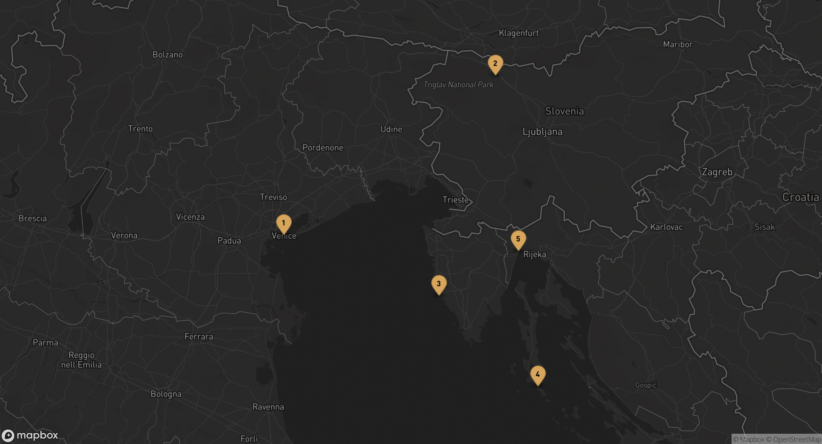
VENICE + BEYOND
09 / Island Grand Tour
Adriatic Islands · highest character
Čikat Bay, standout coastal resorts and a trip that feels unlike another Italy holiday.
Publishable—with two amber ferry days
1
Venice
4n · 24–28 July
2
Lake Bled
4n · 28 July–1 August
3
Rovinj
5n · 1–6 August
4
Mali Lošinj
4n · 6–10 August
5
Opatija Riviera
4n · 10–14 August
SOURCE Mapbox static map + route dataset ↗

Slide 10
VENICE + BEYOND
10 / Ferry warning
The ferry is 20 minutes. The transfer is five hours.
Line 334 is non-reservable for vehicles. A ticket does not guarantee the intended sailing.
ROAD
QUEUE
FERRY
ROAD
Rovinj → Brestova
Summer vehicle line
Brestova → Porozina
Porozina → Mali Lošinj
1h15
1–2h
20m
1h27
REALISTIC DOOR TO DO
Target Brestova 11:30; join queue by 10:00.
Return: leave hotel 08:00–08:15; target Porozina 10:40.
Missed sailing fallback is 12:15; keep lunch unreserved.
4h15–5h
SOURCE Official Jadrolinija line 334 timetable ↗

Slide 11
VENICE + BEYOND
11 / Island Grand Tour
The island stay earns the friction.
Top choices shown with evidence tier; exact-party OTA results do not receive the green direct-inventory badge.
Mali Lošinj · Čikat Bay
Mali Lošinj · Čikat Bay
Mali Lošinj · Čikat Bay
Hotel Bellevue
Boutique Hotel Alhambra
Villa Hygeia
Executive Suite / Bellevue Suite
Čikat Bay Suite with balcony
Private villa buyout
75–93 m²
PROVISIONAL
50 m²
PROVISIONAL
Five suites + two children's rooms
PROVISIONAL
€5,670 / 4 nights
€5,425 / 4 nights
Buyout on request
Separate living room; Bellevue Suite adds a second bedroom and two baths.
Closed double bedroom, living room/sofa and balcony.
Full private villa with salons, cinema, chef and 24-hour butler.
OPEN EVIDENCE ↗
OPEN EVIDENCE ↗
OPEN EVIDENCE ↗
SOURCE Property and booking evidence ↗

Slide 12
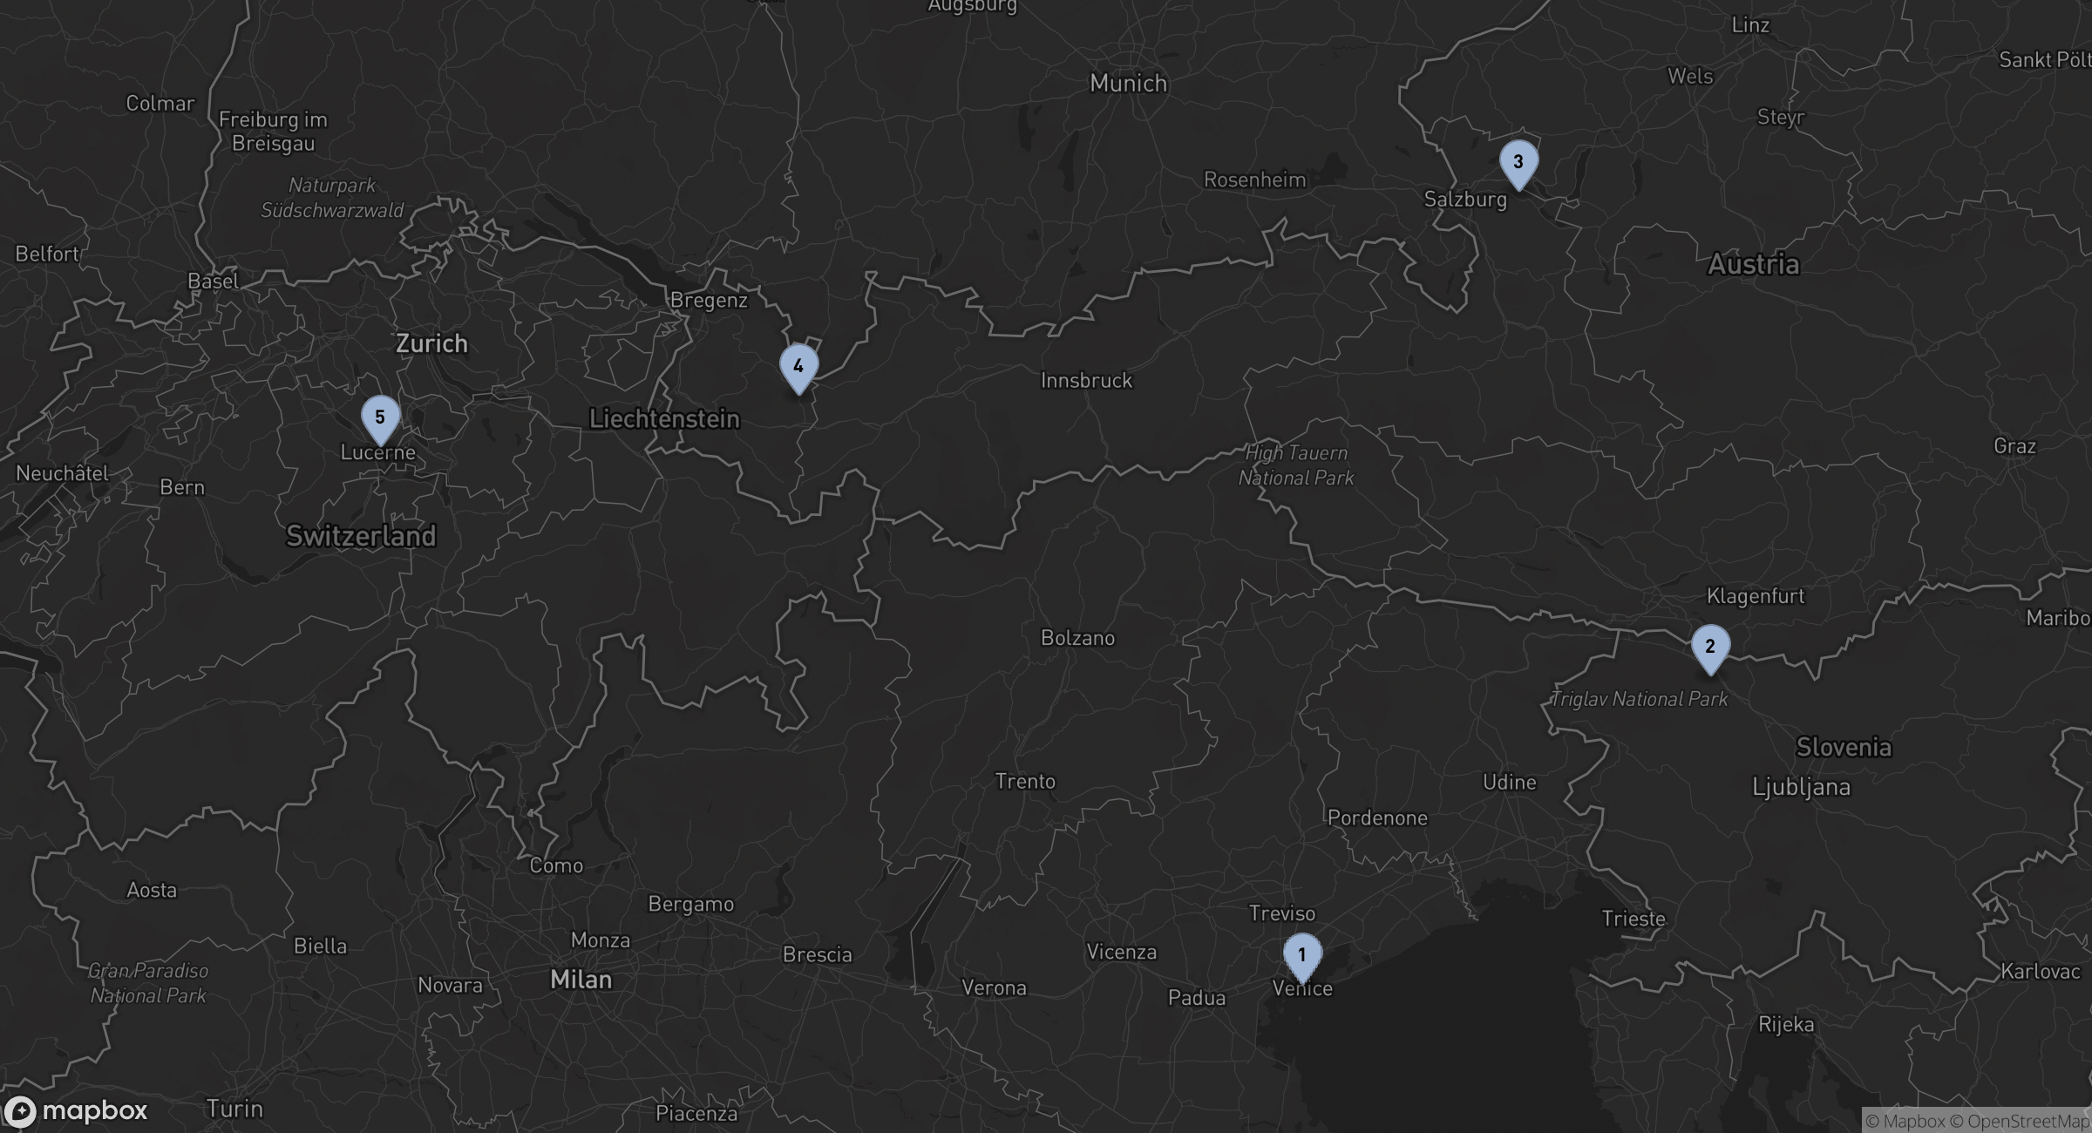
VENICE + BEYOND
12 / Alpine Lakes
Alpine Lakes · strongest exit
Cooler weather, dramatic scenery and a simple Zürich departure.
Cooler air; thinnest luxury inventory
1
Venice
4n · 24–28 July
2
Lake Bled
5n · 28 July–2 August
3
Lake Fuschl
4n · 2–6 August
4
Lech am Arlberg
4n · 6–10 August
5
Lake Lucerne
4n · 10–14 August
SOURCE Mapbox static map + route dataset ↗

Slide 13
VENICE + BEYOND
13 / Alpine Lakes
Use drivers where the train adds friction.
The plan keeps the scenic rail option visible, but a private car is easier for Fuschl → Lech with a toddler.
01
Venice → Lake Bled
3h20–3h45
Recommended departure 10:00
SOURCE ↗
Prebooked private transfer
02
Lake Bled → Lake Fuschl
3h10–3h40
Recommended departure 10:00
SOURCE ↗
Private transfer
03
Lake Fuschl → Lech
4h25–4h50
Car to Salzburg Hbf; 12:56 → Langen 16:34; 20–25 min hotel car
SOURCE ↗
ÖBB Railjet + hotel transfer
04
Lech → Lake Lucerne
2h45–3h15
Recommended departure 10:00
SOURCE ↗
Private transfer
SOURCE ÖBB/SBB schedules and route estimates ↗

Slide 14
VENICE + BEYOND
14 / Alpine Lakes
Alpine availability needs compromise.
Top choices shown with evidence tier; exact-party OTA results do not receive the green direct-inventory badge.
Lech am Arlberg
Lucerne city
Lucerne waterfront
Balma Restaurant Suites
Neustadt Apartments
Liv Suites
One-bedroom suite
One-bedroom apartment
One-bedroom suite
54 m²
PROVISIONAL
60 m²
PROVISIONAL
42 m² · compact tactical option
PROVISIONAL
US$1,964 / 4 nights
US$2,090 / 4 nights
US$1,481 / 4 nights
Closed bedroom and living room.
Closed bedroom, living room and kitchen.
Closed bedroom and living room; self check-in.
OPEN EVIDENCE ↗
OPEN EVIDENCE ↗
OPEN EVIDENCE ↗
SOURCE Property and booking evidence ↗

Slide 15
VENICE + BEYOND
15 / Estimated cost
Plan on $38,000–$88,000 for the full trip.
Twenty-one nights for two adults and a 16-month-old with a purchased airline seat. The inbound private charter to Venice is excluded.
LINE ITEM
SLOW ADRIATIC
ISLAND GRAND TOUR
ALPINE LAKES
Lodging
$19,600–$41,900
$22,400–$44,600
$15,000–$42,000
Ground transport
$2,600–$6,300
$2,300–$5,100
$4,000–$8,500
Return flights
$7,500–$11,100
$7,500–$11,100
$14,400–$16,700
Dining
$4,500–$9,000
$4,500–$9,000
$5,000–$10,000
Activities
$600–$1,800
$700–$2,000
$800–$2,500
Contingency
$3,500–$7,000
$3,700–$7,200
$3,900–$8,000
ESTIMATED TOTAL
$38,000–$77,000
$41,000–$79,000
$43,000–$88,000
Includes a 10% contingency. Excludes inbound private charter, shopping, insurance and discretionary gratuities. Planning FX: €1 = US$1.14.
SOURCE ECB reference rate + shared trip cost model ↗

Slide 16
VENICE + BEYOND
16 / Flights
Zürich wins the premium-cabin exit.
JFK/EWR is the explicit default assumption. Prices below are indicative metasearch snapshots for three purchased seats—not airline-held fares.
SWISS
Zürich → New York JFK
10:00 AM → 12:50 PM on Fri 14 Aug
8h50 nonstop
US$16,675 indicative total for 3 business seats
United
Zürich → Newark
10:10 AM → 1:30 PM on Fri 14 Aug
9h20 nonstop
US$16,675 indicative total for 3 Polaris seats
LOT Polish Airlines
Zagreb → New York JFK
12:50 PM → 8:20 PM via Warsaw
13h30 · 2h25 connection
US$7,512 indicative total for 3 business seats
Turkish Airlines
Zagreb → New York JFK
8:25 PM → 4:35 AM +1 via Istanbul
14h10 · 1h25 connection
US$11,124 indicative total for 3 business seats
RECOMMENDATION
Buy the toddler a seat; request a direct lap-infant quote only as a price comparator.
SOURCE Airline-direct booking portals + indicative schedule search ↗

Slide 17
VENICE + BEYOND
17 / Recommendation
Book Slow Adriatic first.
It has the best ratio of distinction to recovery time. Keep the Island route as the emotional alternative; choose Alpine only if the Zürich nonstop matters most.
01
TODAY
Hold Venice
Cipriani vs Ca’ di Dio
02
NEXT
Lock Hotel Lone
Only two Gallery Suites were visible
03
THEN
Drivers + child seat
Get cross-border approval in writing
04
LAST
Flights
Reprice airline-direct for three seats
URGENT GAPS
Bled luxury hotels, Lake Fuschl, and Lucerne resort residences did not surface three direct verified-live family layouts. The dossier keeps those shortfalls visible.
OPEN LOCAL INTERACTIVE PLANNER ↗

